Slide 1

Superstore Sales & Profitability Analysis
Data Storytelling & Statistical Validation
Analyst
Smit Shewale
Programme
Data Analytics Internship Project @ApexPlanet

Slide 2

Business Objective
This analysis explores the Superstore dataset to uncover actionable insights across sales, profitability, regions, and customer segments — driving smarter strategic decisions.
Analyse Trends
Examine sales and profit trends over time to identify growth patterns and seasonal fluctuations.
Identify Performance
Pinpoint high-performing and low-performing categories, sub-categories, and products.
Regional & Segment Insights
Understand how different regions and customer segments contribute to overall revenue.
Generate Recommendations
Deliver data-backed business recommendations validated through statistical analysis.

Slide 3
Dataset Overview & Tools
Dataset Summary
Tools & Technologies
The Superstore dataset contains 9,994 transaction records across 21 features, capturing sales activity across the United States. Key columns analysed include:
Sales
Profit
Python
Pandas
Category
Region
Jupyter Notebook
Power BI / Excel
Segment
Product Name

Slide 4
Key Performance Indicators
A snapshot of overall business performance derived from the Superstore dataset.
$2.3M
$286K
Total Sales
Total Profit
Across all regions and segments
Net profit across all transactions
12.5%
#1
Profit Margin
Top Category
Overall average margin
Technology
#1
#1
Top Region
Top Segment
West
Consumer

Slide 5
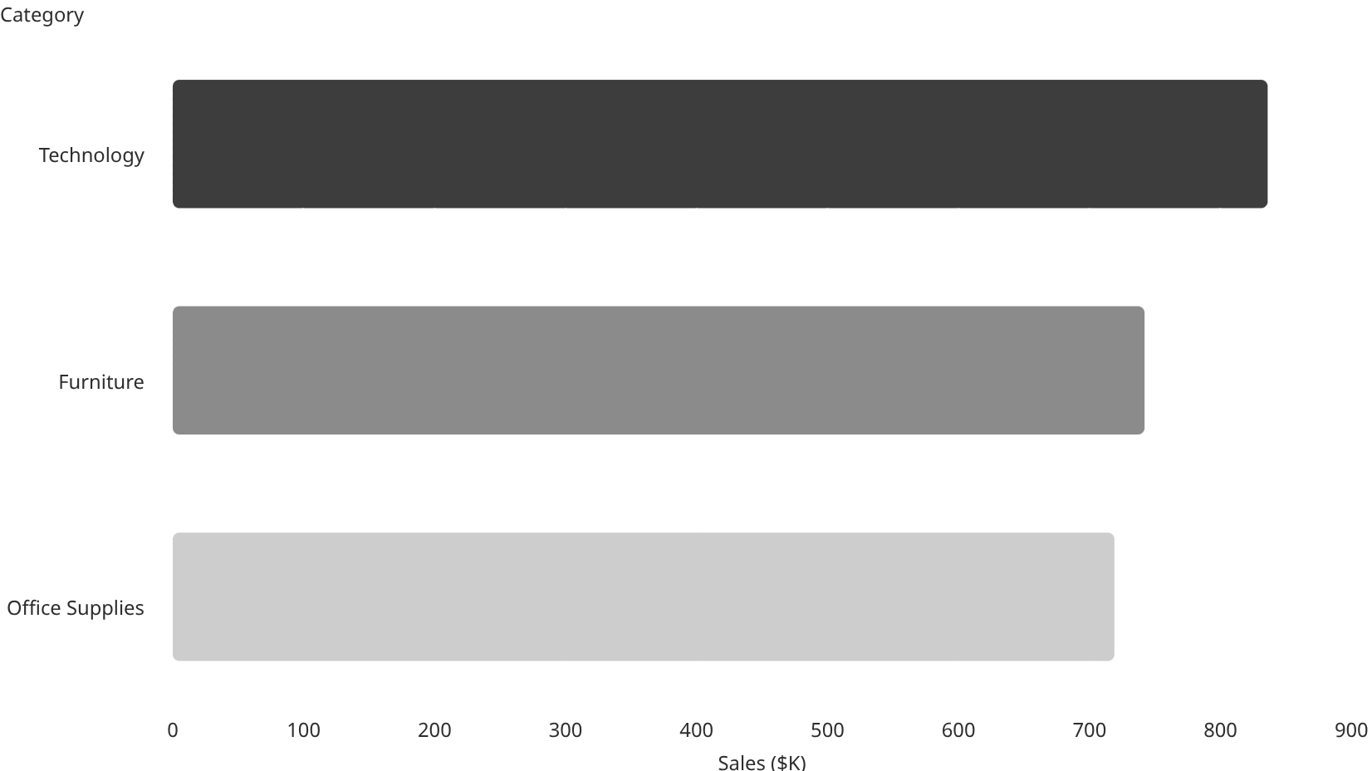
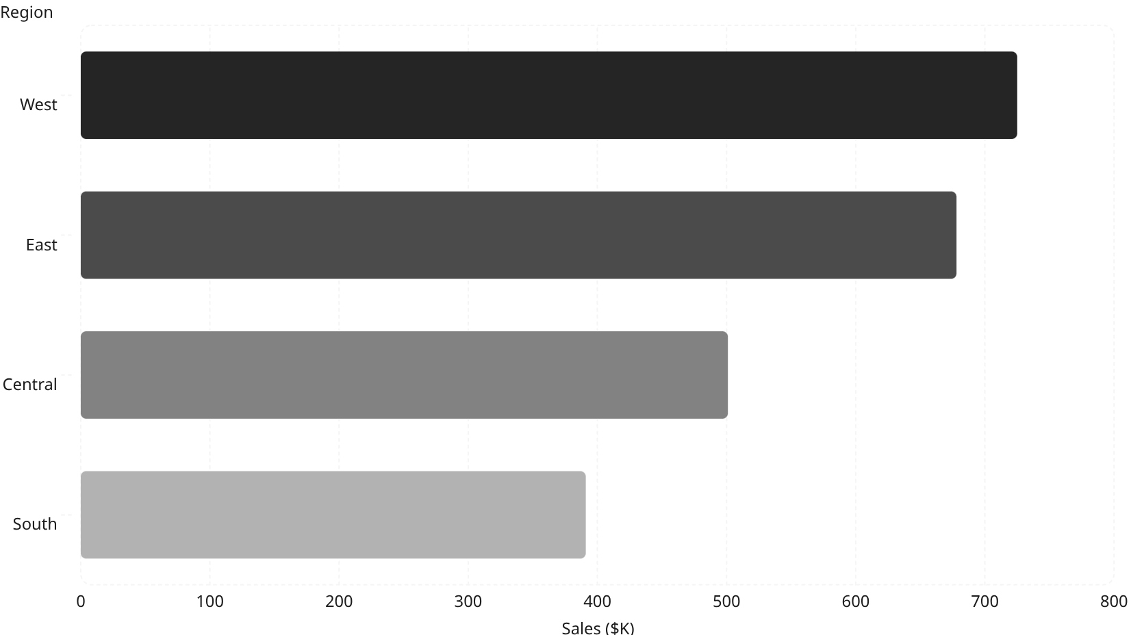

Sales Analysis
Technology leads all categories in revenue, while the West region drives the highest geographical contribution to total sales.
836
725
678
742
501
719
391
Key Insight: Technology accounts for ~36% of total sales. The West region alone contributes nearly 32% of overall revenue — making it the most strategically valuable geography.

Slide 6
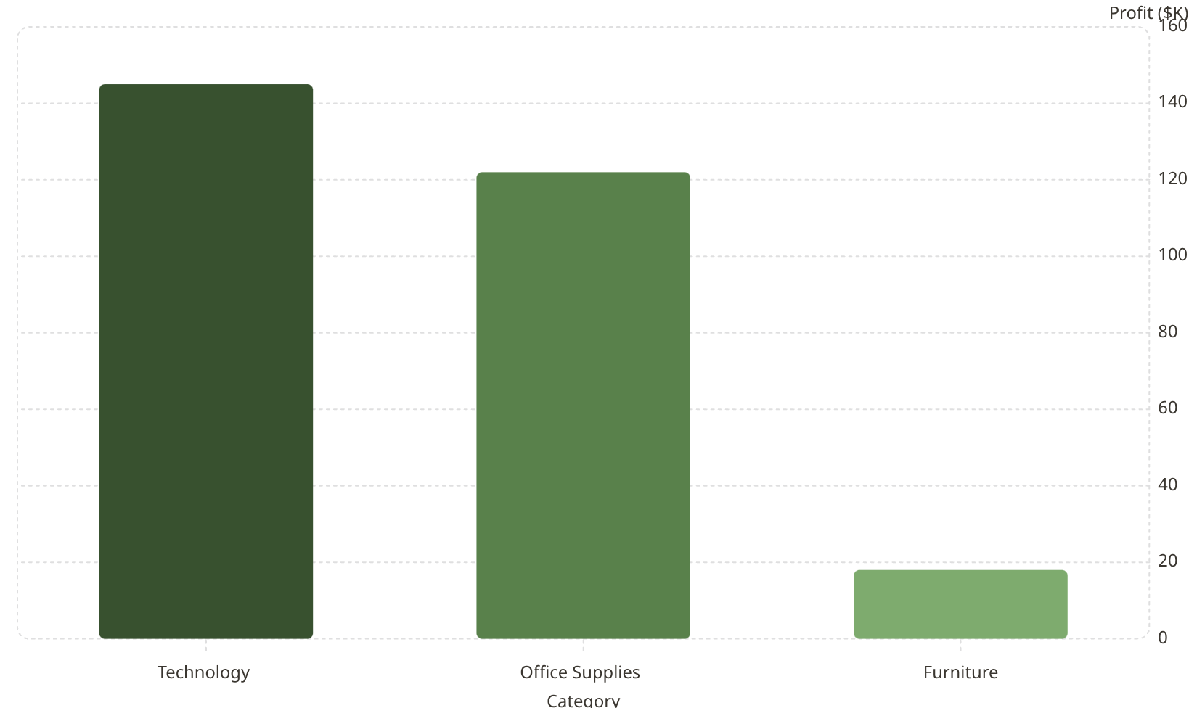
Profit Analysis
Whilst Technology generates both high sales and strong profits, Furniture trails significantly — highlighting a margin problem that warrants strategic intervention.
Sub-Category Profitability Highlights
145
122
🏆 Copiers
📱 Phones
Highest sub-category profit margin
Strong sales with healthy margin
🪑 Tables
📦 Bookcases
18
Negative profit — high discount pressure
Low profitability despite decent volume

Slide 7

Customer & Product Insights
Segment Contribution to Sales
Top-Performing Products
These sub-categories consistently rank highest in both revenue and volume across all regions:
01
Phones
Highest-grossing sub-category in Technology
02
Chairs
Top performer within the Furniture category
Consumer: 50.54%
03
Corporate: 30.74%
Storage
Home Office: 18.72%
Consistent volume driver in Office Supplies

Slide 8

Interactive Dashboard Showcase
An interactive dashboard was built in Power BI / Excel to deliver real-time business insights with dynamic filtering and drill-down capability.
Dynamic Filters
Live KPI Cards
Slice by region, segment, category, and date range instantly
Total Sales, Profit, and Margin update in real time
Visual Charts
Bar, donut, and map charts for rapid decision-making

Slide 9
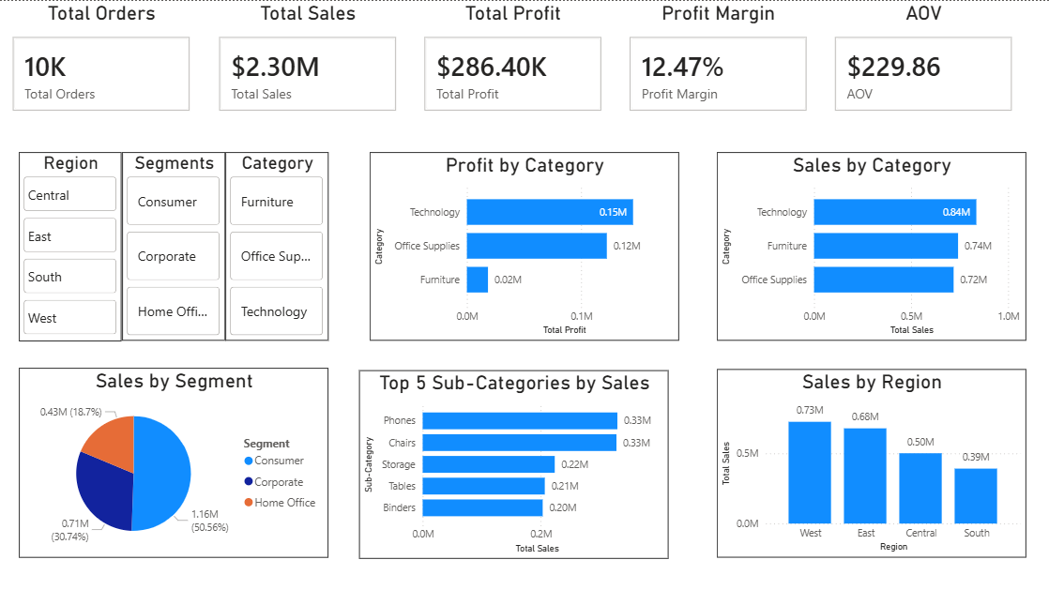
Dashboard Screenshot

Slide 10
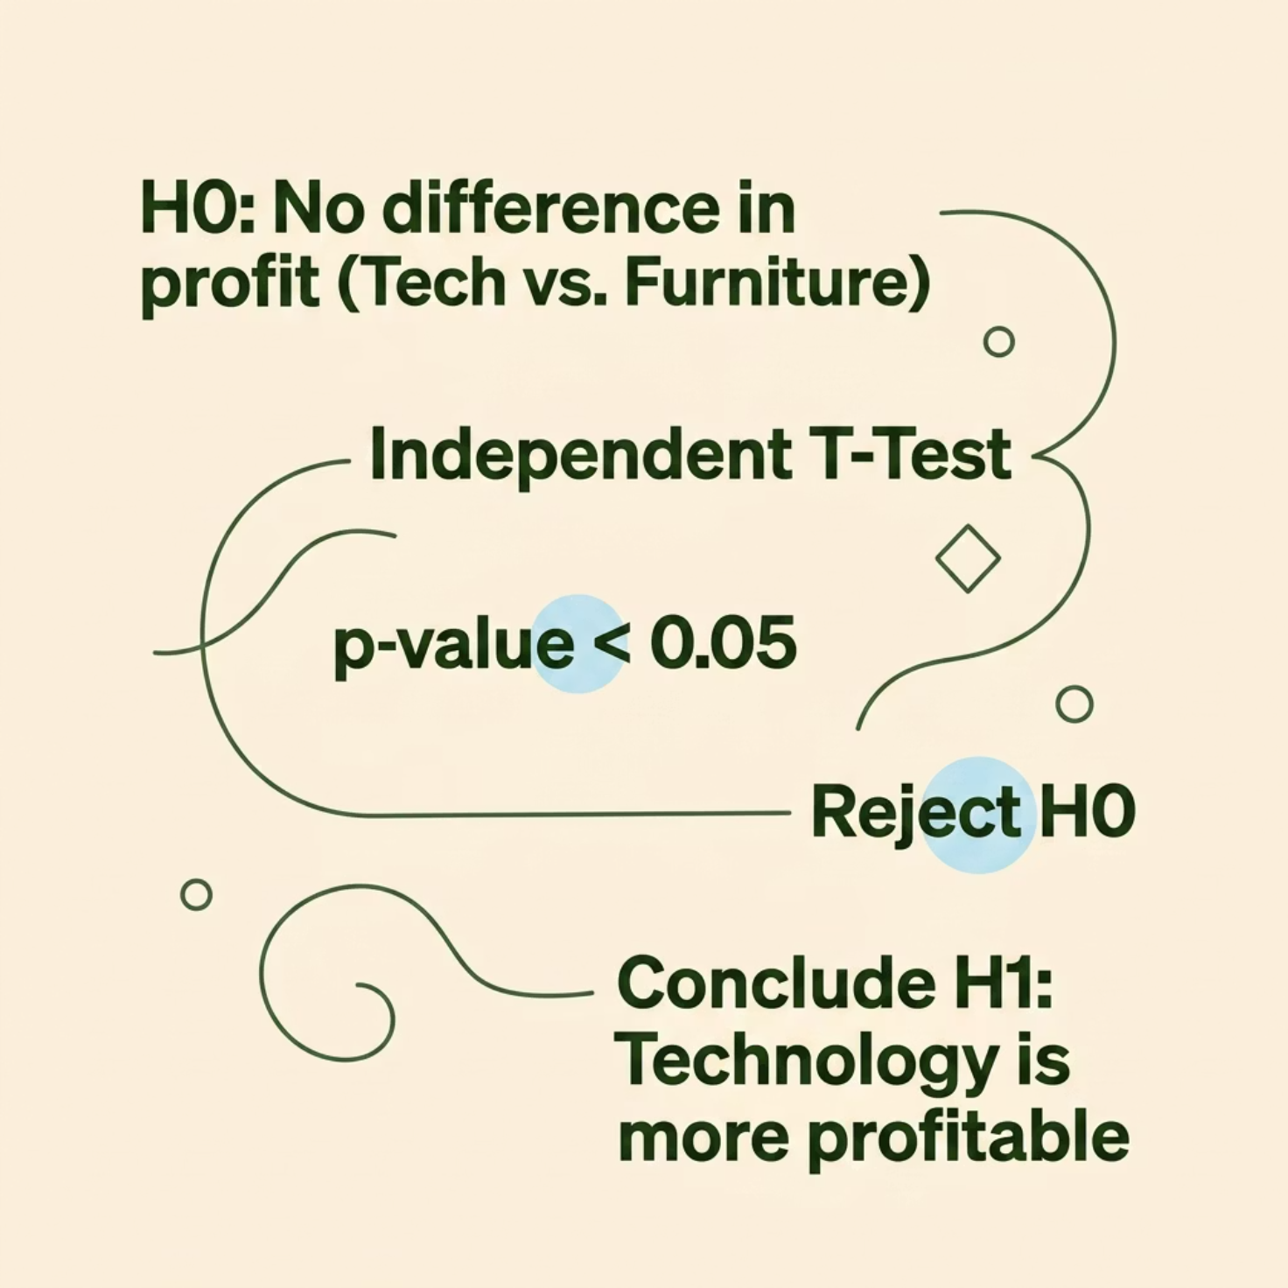


Statistical Validation & Hypothesis Testing
Business Question: Is the Technology category significantly more profitable than Furniture?
H₀ — Null Hypothesis
No significant difference in average profit between Technology and Furniture
H₁ — Alternative Hypothesis
Technology category has a statistically higher average profit
Method: Independent T-Test
p-value < 0.05 — Null hypothesis rejected at 95% confidence level
Conclusion: Technology is statistically and significantly more profitable than Furniture. Data validates the strategic case for increased investment.

Slide 11

Recommendations & Conclusion
1
2
Invest in Technology
Fix Furniture Margins
Expand product range and marketing spend in the highest-margin category
Revise discount strategies and pricing models for Tables and Bookcases
3
4
Double Down on the West
Strengthen Consumer Loyalty
Prioritise marketing and logistics investment in the top-performing region
Develop loyalty programmes targeting the Consumer segment — the largest revenue driver
Final Conclusion: Technology is the star performer; Furniture demands profitability optimisation. Statistical testing validates these insights — empowering confident, data-driven strategic decisions.
Thank You — Smit Shewale | Data Analytics Internship Project @ApexPlanet

